Slide 1
UNIT II

Slide 2
Inheritance in Java
* Inheritance in Java is a mechanism in which one object acquires all the properties and behaviors of a parent object. It is an important part of OOPs(Object Oriented programming system).
* The idea behind inheritance in Java is that you can create new classes
that are built upon existing classes.
* When you inherit from an existing class, you can reuse methods and fields of the parent class.
*Moreover, you can add new methods and fields in your current class also.Inheritance represents the IS-A relationship which is also known as a parent-child relationship

Slide 3
Why use inheritance in java
o 1.For Method Overriding
---→(so runtime polymorphism can be achieved).
2. For Code Reusability.
Terms used in Inheritance
Class: A class is a group of objects which have common properties. It is a template or blueprint from which objects are created.
Sub Class/Child Class: Subclass is a class which inherits the other class. It is also called a derived class, extended class, or child class.

Slide 4
Super Class/Parent Class: Superclass is the class from where a subclass inherits the features. It is also called a base class or a parent class.
Reusability: As the name specifies, reusability is a mechanism which facilitates you to reuse the fields and methods of the existing class when you create a new class. You can use the same fields and methods already defined in the previous class.
class Subclass-name extends Superclass-name
{
//methods and fields
}
Note: The extends keyword indicates that you are making a new class that derives from an existing class. The meaning of "extends" is to increase the functionality

Slide 5
class Employee{
float salary=40000;
}
class Programmer extends Employee{
int bonus=10000;
public static void main(String args[]){
Programmer p=new Programmer();
System.out.println("Programmer salary is:"+p.salary);
System.out.println("Bonus of Programmer is:"+p.bonus);
}
}
Programmer is the subclass and Employee is the superclass. The relationship between the two classes is Programmer IS-A Employee. It means that Programmer is a type of Employee.

Slide 6
Types of inheritance in java
On the basis of class, there can be three types of inheritance in java: single, multilevel and hierarchical.
In java programming, multiple and hybrid inheritance is supported through interface only. We will learn about interfaces later.

Slide 7
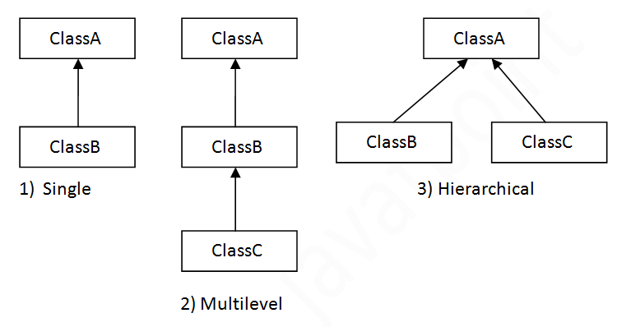

Slide 8
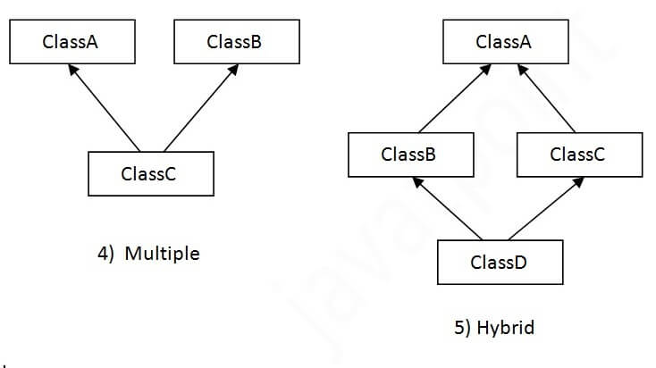

Slide 9
Single Inheritance Example
When a class inherits another class, it is known as a single inheritance.
class Animal{
void eat(){System.out.println("eating...");}
}
class Dog extends Animal{
void bark(){System.out.println("barking...");}
}
class TestInheritance{
public static void main(String args[]){
Dog d=new Dog();
d.bark();
d.eat();
}}

Slide 10
Multilevel Inheritance Example
When there is a chain of inheritance, it is known as multilevel inheritance
class Animal{
void eat(){System.out.println("eating...");}
}
class Dog extends Animal{
void bark(){System.out.println("barking...");}
}
class BabyDog extends Dog{
void weep(){System.out.println("weeping...");}
}
class TestInheritance2{
public static void main(String args[]){
BabyDog d=new BabyDog();
d.weep();
d.bark();
d.eat();
}}

Slide 11
Hierarchical Inheritance Example
When two or more classes inherits a single class, it is known as hierarchical inheritance.
class Animal{
void eat(){System.out.println("eating...");}
}
class Dog extends Animal{
void bark(){System.out.println("barking...");}
}
class Cat extends Animal{
void meow(){System.out.println("meowing...");}
}
class TestInheritance3{
public static void main(String args[]){
Cat c=new Cat();
c.meow();
c.eat();
//c.bark();//C.T.Error
}}

Slide 12
super key word
The super keyword in Java is a reference variable which is used to refer immediate parent class object.
Usage of Java super Keyword
* super can be used to refer immediate parent class instance variable.
* super can be used to invoke immediate parent class method.
* super() can be used to invoke immediate parent class constructor.

Slide 13
class Animal {
public void move() {
System.out.println("Animals can move");
}
public void eat()
{
System.out.println(" Animals Will eat.");
}
}
class Dog extends Animal {
public void move() {
super.move(); // invokes the super class method
System.out.println("Dogs can walk and run");
super.eat();
}
}
public class TestDog {
public static void main(String args[]) {
Dog d=new Dog();
d.move();
Animal obj = new Dog(); // Animal reference but Dog object
obj.move(); // runs the method in Dog class
}
}

Slide 14
Preventing inheritance
While one of Java's strengths is the concept of inheritance, in which one class can derive from another, sometimes it's desirable to prevent inheritance by another class. To prevent inheritance, use the keyword "final" when creating the class.
Why Prevent Inheritance?
The main reason to prevent inheritance is to make sure the way a class behaves is not corrupted by a subclass.

Slide 15
Suppose we have a class Account and a subclass that extends it, OverdraftAccount. Class Account has a method getBalance()
public final class Account
{
statements
}
This means that the Account class cannot be a superclass, and the OverdraftAccount class can
no longer be its subclass.
Sometimes, you may wish to limit only certain behaviors of a superclass to avoid corruption
by a subclass. For example, OverdraftAccount still could be a subclass of Account, but it should
be prevented from overriding the getBalance() method.

Slide 16
public class Account {
private double balance;
public final double getBalance()
{
return this.balance;
}
}
final is a non-access modifier for Java elements. The final modifier is used for finalizing the implementations of classes, methods, and variables.

Slide 17
What are ways to Prevent Inheritance in Java Programming?
There are 2 ways to stop or prevent inheritance in Java programming.
By using final keyword with a class orBy using a private constructor in a class.
Final Keyword In Java
The final keyword in java is used to restrict the user. The java final keyword can be used in many context. Final can be:
1. variable
2. method
3. class

Slide 18
The final keyword can be applied with the variables, a final variable that have no value it is called blank final variable or uninitialized final variable. It can be initialized in the constructor only. The blank final variable can be static also which will be initialized in the static block only.
Java final variable
If you make any variable as final, you cannot change the value of final variable(It will be constant)

Slide 19
class Bike9{
final int speedlimit=90;//final variable
void run(){
speedlimit=400;
}
public static void main(String args[]){
Bike9 obj=new Bike9();
obj.run();
}
}
63.151/Bike9.java:4: error: cannot assign a value to final variable speedlimit
speedlimit=400;
^
1 error

Slide 20
Java final method
If you make any method as final, you cannot override it.
class Bike{
final void run(){System.out.println("running");}
}
class Honda extends Bike{
void run(){System.out.println("running safely with 100kmph");}
public static void main(String args[]){
Honda honda= new Honda();
honda.run();
}
}
Compile by: javac Honda.java
63.151/Honda.java:6: error: run() in Honda cannot override run() in Bike with 100kmph");}
^
overridden method is final
1 error

Slide 21
Java final class
If you make any class as final, you cannot extend it.
final class Bike{}
class Honda1 extends Bike{
void run(){System.out.println("running safely with 100kmph");}
public static void main(String args[]){
Honda1 honda= new Honda1();
honda.run();
}
}
Compile by: javac Honda1.java
3.133/Honda1.java:3: error: cannot inherit from final Bike class Honda1 extends Bike{}

Slide 22
Polymorphism
Polymorphism is briefly described as “one interface, many implementations”.
Polymorphism in Java is a concept by which we can perform a single action in different ways.
1. Compile time polymorphism
2. Run time polymorphism
Compile time polymorphism is method overloading whereas Runtime time polymorphism is done using inheritance and interface.

Slide 23
Method Overriding in Java
If subclass (child class) has the same method as declared in the parent class, it is known as method overriding in Java.
Rules for Java Method Overriding
The method must have the same name as in the parent class
The method must have the same parameter as in the parent class.
There must be an IS-A relationship (inheritance).

Slide 24
class Vehicle
{
void run(){
System.out.println("Vehicle is running");
}
}
class Bike2 extends Vehicle{
void run()
{
System.out.println("Bike is running safely");
}
public static void main(String args[]){
Bike2 obj = new Bike2();//creating object
obj.run();//calling method
} } OUT PUT: Bike is running safely

Slide 25
In Java, runtime polymorphism or dynamic method dispatch is a process in which a call to an overridden method is resolved at runtime rather than at compile-time. In this process, an overridden method is called through the reference variable of a superclass.
class Car {
void run()
{ System.out.println(“car is running”); }
}
class Audi extends Car {
void run()
{ System.out.prinltn(“Audi is running safely with 100km”); }
public static void main(String args[])
{
Car b= new Audi(); //upcasting
b.run();
} }
Since method invocation is determined by the JVM not compiler, it is known as runtime polymorphism.

Slide 26
class Bank{
float getRateOfInterest(){return 0;}
}
class SBI extends Bank{
float getRateOfInterest(){return 8.4f;}
}
class ICICI extends Bank{
float getRateOfInterest(){return 7.3f;}
}
class AXIS extends Bank{
float getRateOfInterest(){return 9.7f;}
}
class TestPolymorphism{
public static void main(String args[]){
Bank b;
b=new SBI();
System.out.println("SBI Rate of Interest: "+b.getRateOfInterest());
b=new ICICI();
System.out.println("ICICI Rate of Interest: "+b.getRateOfInterest());
b=new AXIS();
System.out.println("AXIS Rate of Interest: "+b.getRateOfInterest());
}
}

Slide 27
Java Abstract Class and Abstract Methods
A class which is declared with the abstract keyword is known as an abstract class in Java. It can have abstract (method with out body) and non-abstract methods (method with the body).
Abstraction in Java
Abstraction is a process of hiding the implementation details and showing only functionality to the user.
There are two ways to achieve abstraction in java
Abstract class (0 to 100%)
Interface (100%)

Slide 28
Abstract class in Java
A class which is declared as abstract is known as an abstract class. It can have abstract and non-abstract methods. It needs to be extended and its method implemented. It cannot be instantiated.
abstract class A{}
Points to Remember
An abstract class must be declared with an abstract keyword.
It can have abstract and non-abstract methods.
It cannot be instantiated.
It can have constructors and static methods also.
It can have final methods which will force the subclass not to change the body of the method.

Slide 29
Abstract Method in Java
A method which is declared as abstract and does not have implementation is known as an abstract method.
abstract void printStatus();//no method body and abstract
abstract class Bike{
abstract void run();
}
class Honda4 extends Bike{
void run(){System.out.println("running safely");}
public static void main(String args[]){
Bike obj = new Honda4();
obj.run();
}
} OUT PUT : running safely

Slide 30
abstract class Shape{
abstract void draw();
}
//In real scenario, implementation is provided by others i.e. unknown by end user
class Rectangle extends Shape{
void draw(){System.out.println("drawing rectangle");}
}
class Circle1 extends Shape{
void draw(){System.out.println("drawing circle");}
}
//In real scenario, method is called by programmer or user
class TestAbstraction1{
public static void main(String args[]){
Shape s=new Circle1
s.draw();
}
} output: drawing circle

Slide 31
Abstract class having constructor, data member and methods
abstract class Bike{
Bike(){System.out.println("bike is created");}
abstract void run();
void changeGear(){System.out.println("gear changed");}
}
class Honda extends Bike{
void run(){System.out.println("running safely..");}
}
class TestAbstraction2{
public static void main(String args[]){
Bike obj = new Honda();
obj.run();
obj.changeGear();
}
}
bike is created
running safely..
gear changed

Slide 32
Interface
An interface in Java is a blueprint of a class. It has static constants and abstract methods.
An interface in Java is similar to class. It is a collection of abstract methods.
The interface in Java is a mechanism to achieve abstraction. There can be only abstract methods in the Java interface, not method body. It is used to achieve abstraction and multiple inheritance in Java.
Java Interface also represents the IS-A relationship.
It cannot be instantiated just like the abstract class.

Slide 33
A class implements an interface, thereby inheriting the abstract methods of the interface.
Writing an interface is similar to writing a class. But a class describes the attributes and behaviors of an object. And an interface contains behaviors that a class implements.
Why use Java interface?
1) It is used to achieve abstraction.
2) By interface, we can support the functionality of multiple inheritance.

Slide 34
How to declare an interface?
An interface is declared by using the interface keyword. It provides total abstraction; means all the methods in an interface are declared with the empty body, and all the fields are public, static and final by default. A class that implements an interface must implement all the methods declared in the interface.
interface <interface_name>
{
// declare constant fields
// declare methods that abstract
// by default.
}

Slide 35
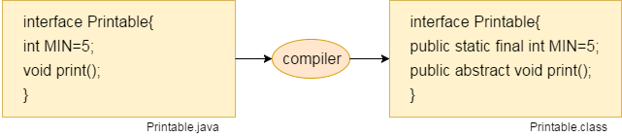
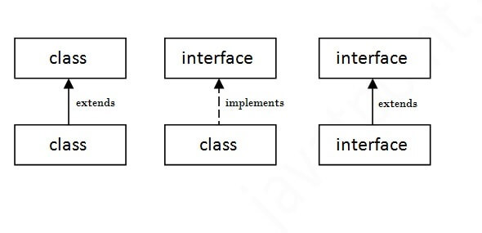
The relationship between classes and interfaces
A class extends another class, an interface extends another interface, but a class implements an interface.

Slide 36
interface inter
{
int a=10,b=20;
public void add();
}
class c1 implements inter
{
public void add()
{
int sum=a+b;
System.out.println("Sum of numbers is:" +sum);
}
public static void main(String[] srgs)
{
c1 obj= new c1();
obj.add();
}
} output: Sum of numbers is: 30

Slide 37
interface Drawable{
void draw();
}
class Rectangle implements Drawable{
public void draw(){System.out.println("drawing rectangle");}
}
class Circle implements Drawable{
public void draw(){System.out.println("drawing circle");}
}
class TestInterface1{
public static void main(String args[]){
Drawable d=new Circle();
d.draw();
Drawable d1=new Rectangle();
d1.draw();
}} output: drawing circle
drawing rectangle

Slide 38
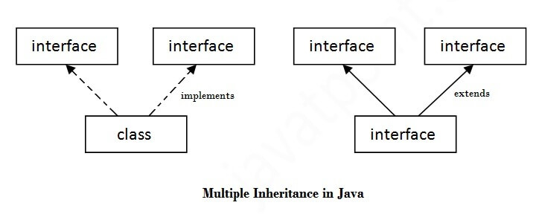
Multiple inheritance in Java by interface
If a class implements multiple interfaces, or an interface extends multiple interfaces, it is known as multiple inheritance.

Slide 39
interface inter
{
int a=10,b=20;
public abstract void add();
}
interface inter1
{
int c=20,d=10;
public abstract void sub();
}
class c1 implements inter,inter1
{
public void add()
{
int sum=a+b;
System.out.println(" Sum of numbers is :" +sum);
}
public void sub()
{
int r=c-d;
System.out.println(" Difference of numbers is :" +r);
}
public static void main(String[] args)
{
c1 obj=new c1();
obj.add();
obj.sub();
}
} Output: Sum of numbers is : 30
Difference of numbers is: 10

Slide 40
Interface inheritance
A class implements an interface, but one interface extends another interface.
interface Printable{
void print();
}
interface Showable extends Printable{
void show();
}
class TestInterface4 implements Showable{
public void print(){System.out.println("Hello");}
public void show(){System.out.println("Welcome");}
public static void main(String args[]){
TestInterface4 obj = new TestInterface4();
obj.print();
obj.show();
} Out put : Hello
} Welcome

Slide 41
Java Nested Interface
An interface, i.e., declared within another interface or class, is known as a nested interface. The nested interfaces are used to group related interfaces so that they can be easy to maintain.
Points to remember
The nested interface must be public if it is declared inside the interface, but it can have any access modifier if declared within the class.
Nested interfaces are declared static

Slide 42
Syntax of nested interface which is declared within the interface
interface interface_name{
...
interface nested_interface_name{
...
}
}
Syntax of nested interface which is declared within the class
class class_name{
...
interface nested_interface_name{
...
}
}

Slide 43
Example of nested interface which is declared within the interface
interface Showable
{
void show();
interface Message
{
void msg();
}
}
class c1 implements Showable.Message
{
public void msg()
{
System.out.println("Hello nested interface");
}
public void show()
{
System.out.println("Welcome to nested interface");
}
public static void main(String args[])
{
c1 obj1=new c1();
obj1.msg();
obj1.show();
}
}
Output: Hello nested interface
Welcome to nested interface

Slide 44
Example of nested interface which is declared within the class
class A
{
interface Message
{
void msg();
void show();
}
}
class inter implements A.Message
{
public void msg()
{
System.out.println("Hello nested interface");
}
public void show()
{
System.out.println(" Welcome to nested interface");
}
public static void main(String args[]){
inter obj1=new inter();
obj1.show();
obj1.msg();
}
}
Output: Welcome to nested interface
Hello nested interface

Slide 45
Java Default Methods
Java provides a facility to create default methods inside the interface. Methods which are defined inside the interface and tagged with default are known as default methods. These methods are non-abstract methods.
interface add
{
public void addition();
default void addition1()
{ int a=1,b=2,c;
c=a+b;
System.out.println(c);
}
static void sub()
{
int l=20,m=10,n;
n=l-m;
System.out.println(n);
}
}
class c1 implements add{
public void addition()
{
int i=1,j=4,k;
k=i+j;
System.out.println(k); }
public static void main(String[] args)
{ add obj=new c1();
obj.addition();
obj.addition1();
add.sub();
}
} output:5
3
10

Slide 46
Difference between abstract class and interface
Abstract class | Interface
1) Abstract class can have abstract and non-abstract methods. | Interface can have only abstract methods. Since Java 8, it can have default and static methods also.
2) Abstract class doesn't support multiple inheritance. | Interface supports multiple inheritance.
3) Abstract class can have final, non-final, static and non-static variables. | Interface has only static and final variables.
4) Abstract class can provide the implementation of interface. | Interface can't provide the implementation of abstract class.
5) The abstract keyword is used to declare abstract class. | The interface keyword is used to declare interface.
6) An abstract class can extend another Java class and implement multiple Java interfaces. | An interface can extend another Java interface only.
7) An abstract class can be extended using keyword "extends". | An interface can be implemented using keyword "implements".
8) A Java abstract class can have class members like private, protected, etc. | Members of a Java interface are public by default.
9)Example:public abstract clasShape{ public abstract void draw(); } | Example: public interface Drawable{ void draw(); }

Slide 47
Java Package
A java package is a group of similar types of classes, interfaces and sub-packages.
Package in java can be categorized in two form, built-in package and user-defined package.
There are many built-in packages such as java, lang, awt, javax, swing, net, io, util, sql etc.
Advantage of Java Package
1) Java package is used to categorize the classes and interfaces so that they can be easily maintained.
2) Java package provides access protection.
3) Java package removes naming collision.

Slide 48
The package keyword is used to create a package in java.
//save as Simple.java
package mypack;
public class Simple{
public static void main(String args[]){
System.out.println("Welcome to package");
}
}

Slide 49
1. Core Packages: Core Packages are predefined packages given by Sun MicroSystems which begin with “java”.
2. Extended Packages: Extended packages are also predefined packages given by Sun Microsystems which begin with “javax”.
3. Third-Party Packages: Third-Party Packages are also predefined packages that are given by some other companies as a part of Java Software. Example:oracle.jdbc, com.mysql, etc

Slide 50

User-Defined Packages in Java
In Java, we can also create user-defined packages according to our requirements. To create the user-defined packages we have to use a java keyword called “package.

Slide 51
Rules:
1. While writing the package name we can specify packages in any number of levels but specifying one level is mandatory.
2. The package statement must be written as the first executable statement in the program.
3. We can write at most one package statement in the program
package Demo;
public class PackageDemo {
public static void main(String args[]) {
System.out.println("Have a Nice Day...!!!");
}
}

Slide 52
How to access package from another package?
There are three ways to access the package from outside the package.
1)import package.*;
2)import package.classname;
3)fully qualified name.
1) Using packagename.*
If you use package.* then all the classes and interfaces of this package will be accessible but not subpackages.
The import keyword is used to make the classes and interface of another package accessible to the current package.

Slide 53
//save by A.java
package pack;
public class A{
public void msg(){System.out.println("Hello");}
}
//save by B.java
package mypack;
import pack.*;
class B{
public static void main(String args[]){
A obj = new A();
obj.msg();
}
}

Slide 54
2) Using packagename.classname
If you import package.classname then only declared class of this package will be accessible.
//save by A.java
package pack;
public class A{
public void msg(){System.out.println("Hello");}
}
//save by B.java
package mypack;
import pack.A;
class B{
public static void main(String args[]){
A obj = new A();
obj.msg();
}
}

Slide 55
3) Using fully qualified name
If you use fully qualified name then only declared class of this package will be accessible. Now there is no need to import. But you need to use fully qualified name every time when you are accessing the class or interface.
//save by A.java
package pack;
public class A{
public void msg(){System.out.println("Hello");}
}
//save by B.java
package mypack;
class B{
public static void main(String args[]){
pack.A obj = new pack.A();//using fully qualified name
obj.msg();
}
}

Slide 56
C:\Users\MRUH\Desktop\javaex\package>javac -d . B.java
C:\Users\MRUH\Desktop\javaex\package>java pack.Simple

Slide 57
Subpackage in java
Package inside the package is called the subpackage. It should be created to categorize the package further.
package pack.package;
class Simple{
public static void main(String args[]){
System.out.println("Hello subpackage");
}
}

